Slide 1

Decoding Dropout Rates
A Multi-Faceted Quantitative Analysis of High School Students' Retention Rate based on social factors & perception of schooling
By Amanda Tran & Han Nguyen

Slide 2
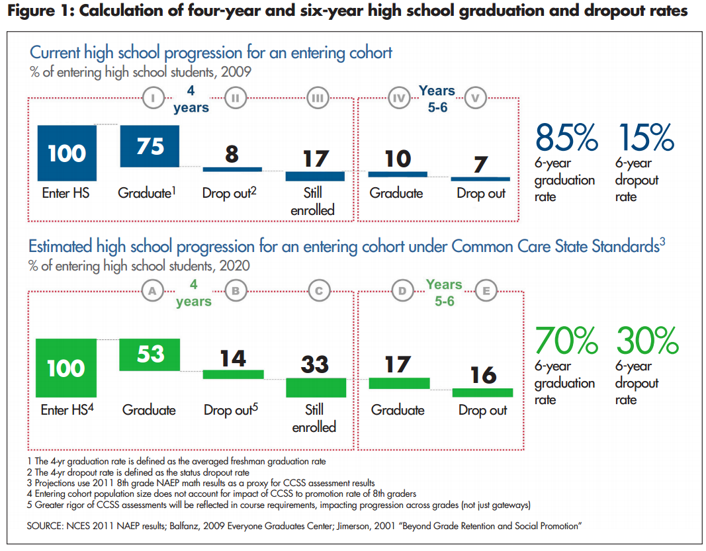
Problem Statement
High school dropout rates in the U.S.
How are schools defining success?
How are students defining success?
Does success = going to college?
This Photo by Unknown author is licensed under CC BY-NC.

Slide 3

Data Source
NCES's 2002-2012 National Longtitudinal Study
Base-year to first Follow-up (F1) student administered surveys

Slide 4
Data cleaning & Composition
Non-response values – NAs
Filtered out homeschooled students
Mutated values:
Hours categories
Extracurricular participation (Boolean)
13,194 responses of 139 variables:
136 factors
3 logical

Slide 5
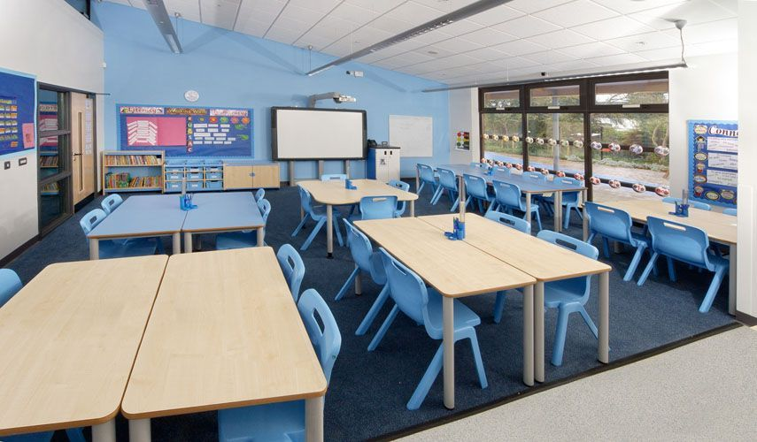
Data Composition
School Environment Perception
Safety
Attendance/Tardiness
Academic Involvements
Attitudes Towards School and Learning
Participation in Learning Enhancements
EC participation
Studying habits (by hours)
Importance of Various Life Aspects
Parental's Education Attainment & Involvement in Education
Dropout

Slide 6

Project’s Outcome
For a student who focuses on certain values in life, an academic counselor can
Identify students’ risk of dropping out
Recommend discussing 1-2 factors from each data category to help students achieve life goals
This Photo by Unknown author is licensed under CC BY.

Slide 7
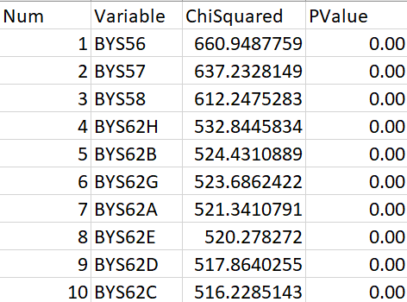
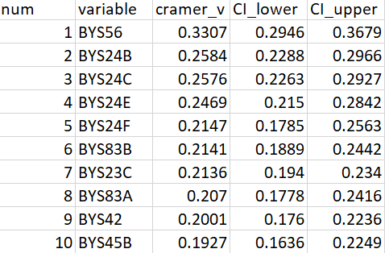
Statistical Tests
Data: Undersampled data (7,303 observations)
Chi-Squared Test for 124 categorical variables against Drop out Status.
All significant
Cramer’s V for 138 categorical variables against Drop out Status.
All significant
Drop out | Continue education
6,621 | 682
Notes:
Currently conducted test based on undersampled data

Slide 8
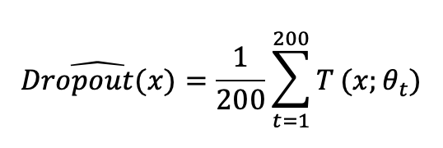
Random Forest
For x = (BYS14, BYS20A, BYS20B, …, BYS85G)
200 Trees, 11 splits/tree

Slide 9
Models & results
Model | True Positive Rate (Sensitivity) | False Positive Rate
Unweighted Random Forest (n = 100)
Undersampled | 4.66% | 0.44%
Oversampled | 13.33% | 6.18%
Full set | 0.66% | 0%
Unweighted Random Forest (n = 200)
Undersampled | 6.00% | 0.48%
Oversampled | 14% | 6.18%
Full set | 0.66% | 0%
Weighted Random Forest (n = 200)
Undersampled | 12.21% | 5.34%
Oversampled | 11.45% | 5.34%
Full set | 11.45% | 5.22%
Weighted Random Forest (n = 200), threshold = .75
Undersampled | 10.68% | 5.22%
Oversampled | 10.68% | 5.22%
Full set | 10.68% | 5.22%
3 approaches:
Original (cleaned) training set
Resampling of the training set (minority class bumped to 10.3%)
Undersampling
Oversampling
Tree numbers bumped from 100 to 200
Class weights changed based on class ratio (10.3%)
Threshold: 0.5 - 0.75

Slide 10
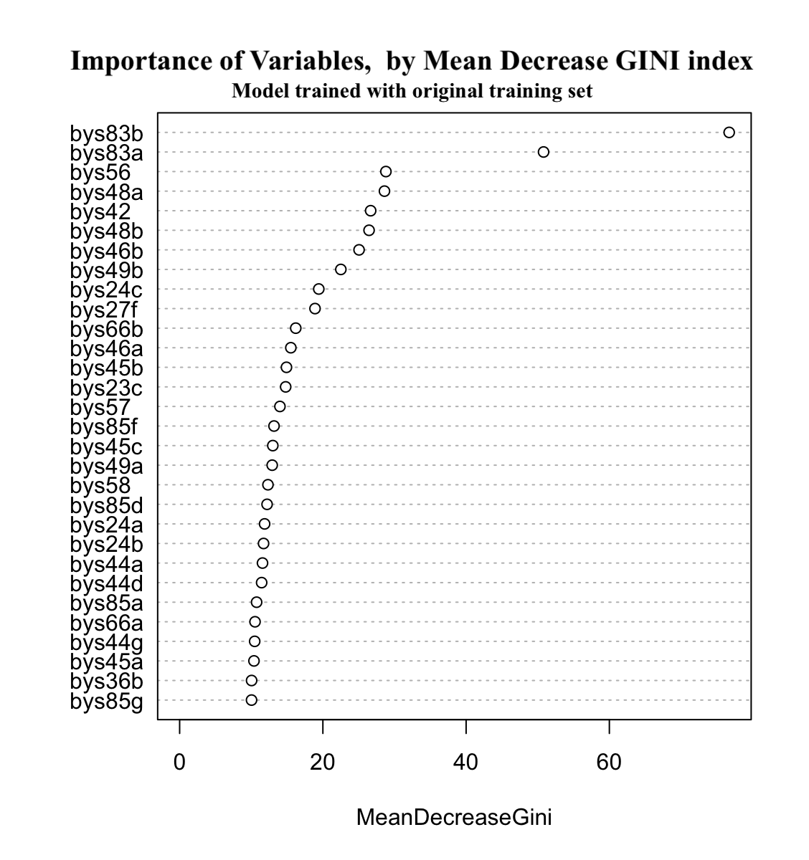
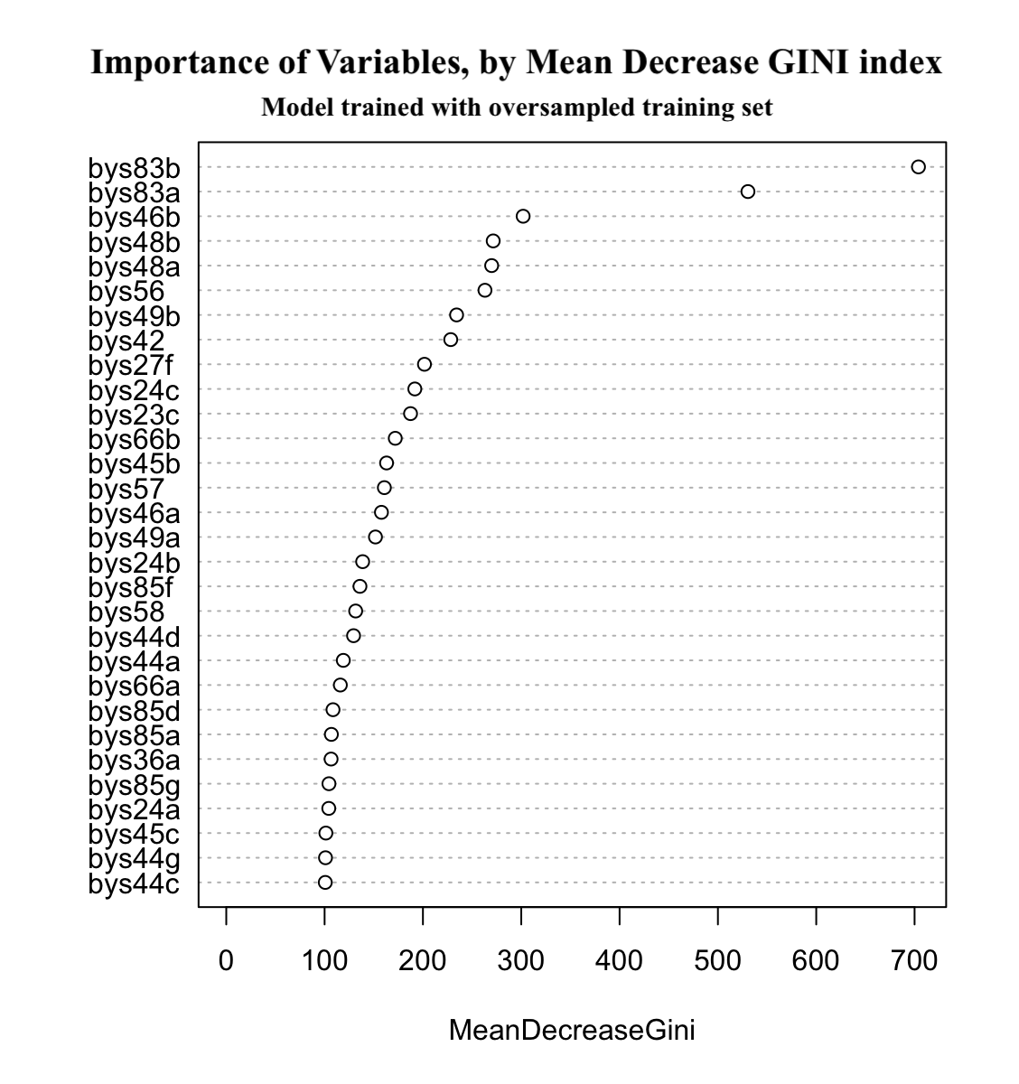
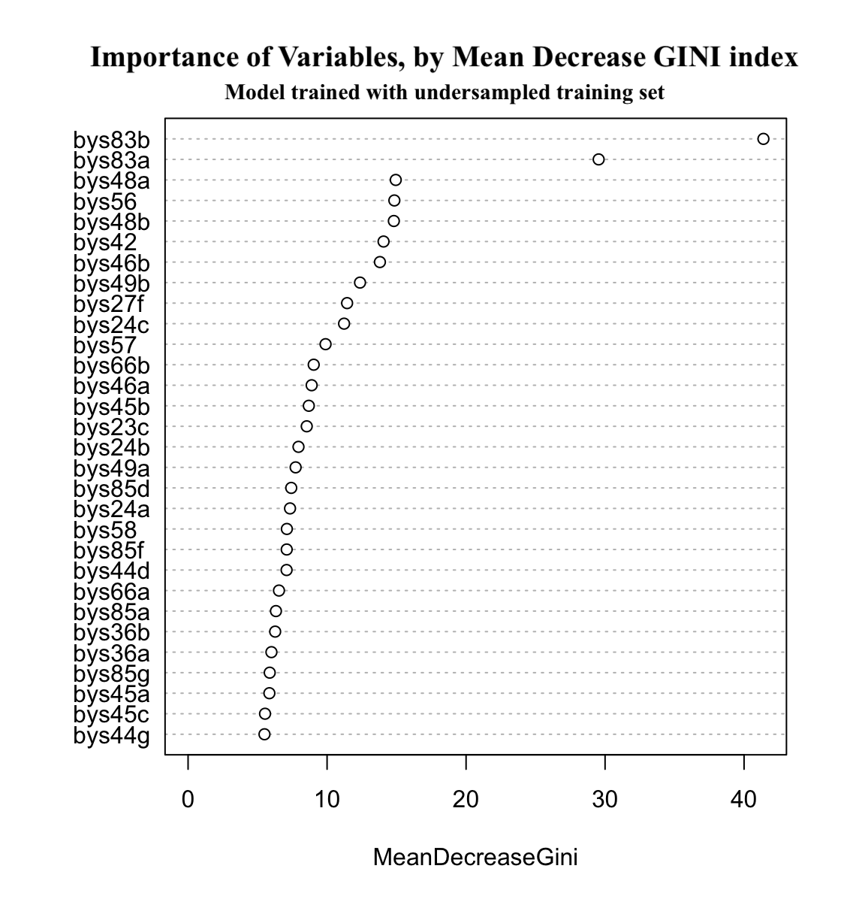
Variables of significance
Matching background knowledge: 83A-B (Father's and Mother's Highest Education Level), 48 & 49A-B (Time spent watching TV & playing video games on weekdays-weekends), 46B (Time spent on computer NOT for school-work), 24C (Absences from school)
Surprise significance: 56 (How far in school student expects to be), 27F (Student plays on a sport team/club)

Slide 11
Logistic Regression
Outcome of Interest: Drop out status (F1DOQFLG)
Three models:
Full model: 127 predictor variables -> convergence failure issue
Selected model: 82 predictor variables with 0.5 as a benchmark
TPR | FPR
66.7% | 0.863%
Important factors are from the following categories: School Environment Perception, Parental Education and Involvement, Importance of Various Life Aspects
Significant factors in both model + stat. tests: Mother’s and Father’s highest level of education, Plans to continue education after high school, How many times suspended/put on probation.
Notes:
Model 1: all factors are significant in the model. Fully predict the dataset without error.
Model 2 still has issues. The probability produced from the log odds coefficients are mostly around 0 and 1.
FPR: students who continued their education but predicted to drop out.

Slide 12
Logistic Regression
Outcome of Interest: Drop out status (F1DOQFLG)
Three models:
Second selected model: 36 predictor variables with 0.5 as a benchmark
TPR | FPR
22.78% | 0.55%
Interpretation Examples:
Students who were suspended or put on probation 1-2 times (category BYS24F2) are roughly 4 times more likely to drop out.
Students who were absent more than 10 times (category BYS24C5) are roughly 8 times more likely to drop out.
Notes:
Model 1: all factors are significant in the model. Fully predict the dataset without error.
Model 2 still has issues. The probability produced from the log odds coefficients are mostly around 0 and 1.
FPR: students who continued their education but predicted to drop out.

Slide 13

Next steps
Cross-validation? Stratified K Folds?
Topic 2: Statistical tests + tree-based methods/SVM
Create a simple interface for the recommendation system
Visualization
Suggested search terms

Slide 14
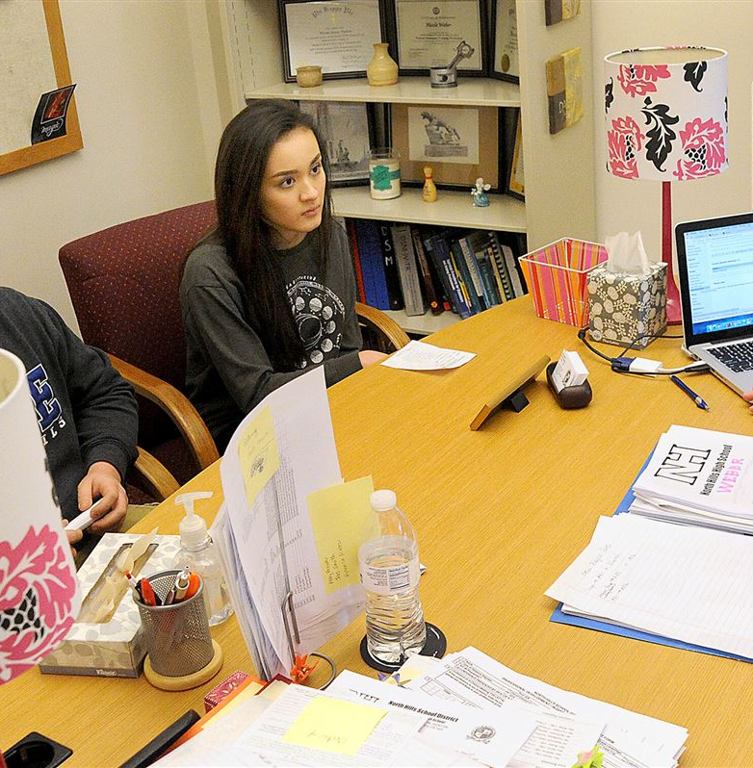
Implications for Stakeholders
Students:
Identify areas of struggle: academic performance, school environment perception, personal issues.
Empower students to understand weak points and work towards improvement.
Parents:
Gain insights into child’s school life.
Guide parental support and advocacy for child’s needs at school.
School Counselors & Teachers:
Receive data-driven insights tailored to each student.
Develop effective intervention strategies and support plans.
Inform teaching strategies and interactions to better support learning and engagement.
School Administration:
Highlight systemic issues contributing to dropout rates.
Guide policy and program decisions to enhance student retention.

Slide 15
Legal & Ethical Considerations
De-identified data
Demographic variables excluded
Deviating from standardized metrics
Support, rather than impose

